Slide 1


Slide 2


Slide 3


Slide 4

Your Minimum Share Capital
P4,000
P800,000
P200,000
P50,000
P20,000

Slide 5

Your Share Capital, Your Choice
How much can a member subscribe? (RA 9520)
Authorized Capital
₱800,000
what BUPCC is registered to raise
Subscribed Capital
₱200,000
25% of Authorized Capital
Per-Member Maximum
₱20,000
10% of Subscribed Capital
Example: a member subscribes ₱10,000 (100 shares of ₱100) → 25% Paid-Up due today: ₱2,500
Full Payment
₱10,100
pay everything today
(₱10,000 + ₱100 membership fee)
12-Month Installment
₱625 / month
₱2,500 down today
₱7,500 balance ÷ 12
24-Month Installment
₱312.50 / month
₱2,500 down today
₱7,500 balance ÷ 24
Minimum Share Capital ₱4,000 (40 shares). Downpayment is never below the 25% Paid-Up. The member can move the amount up or down until the monthly figure feels comfortable.
Try it live: bupcc.com/share-capital-calculator.html (Recruiter PIN) · Illustration only

Slide 6
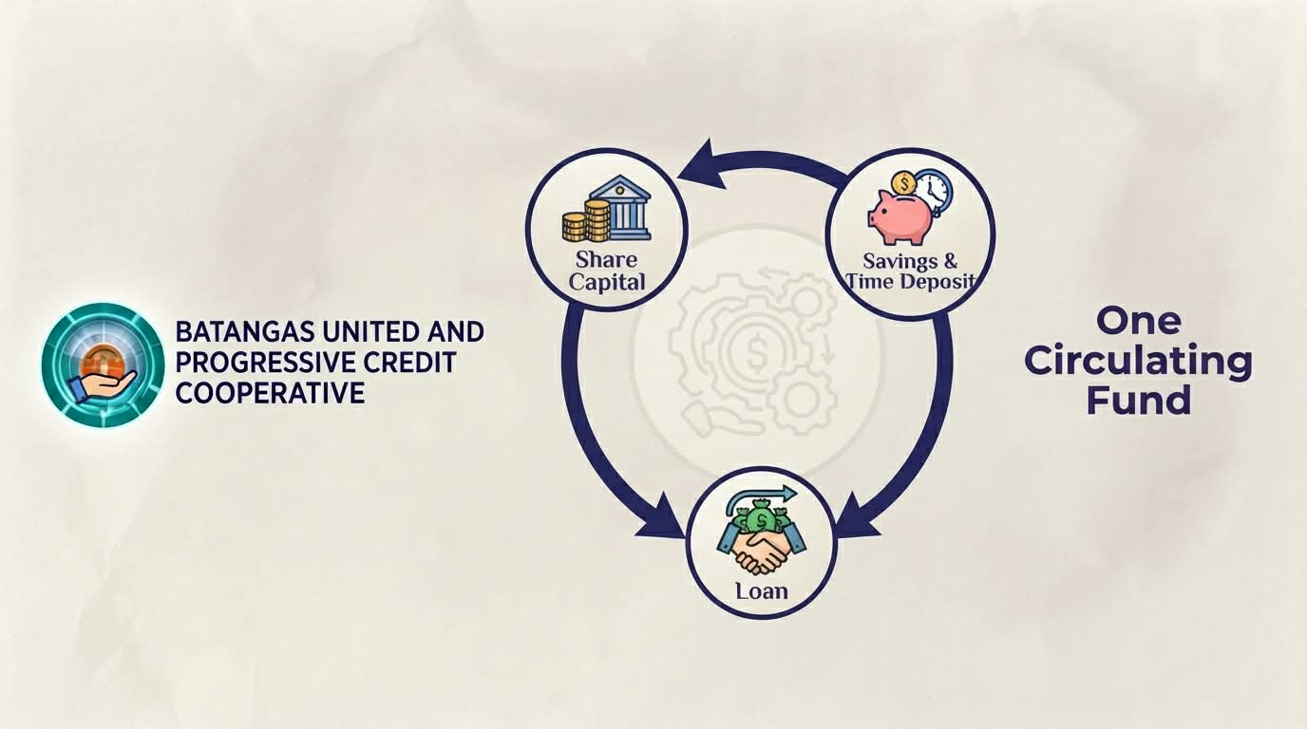
~ 3 – 5%
2 - 4% per year
1 - 2% per month

Slide 7
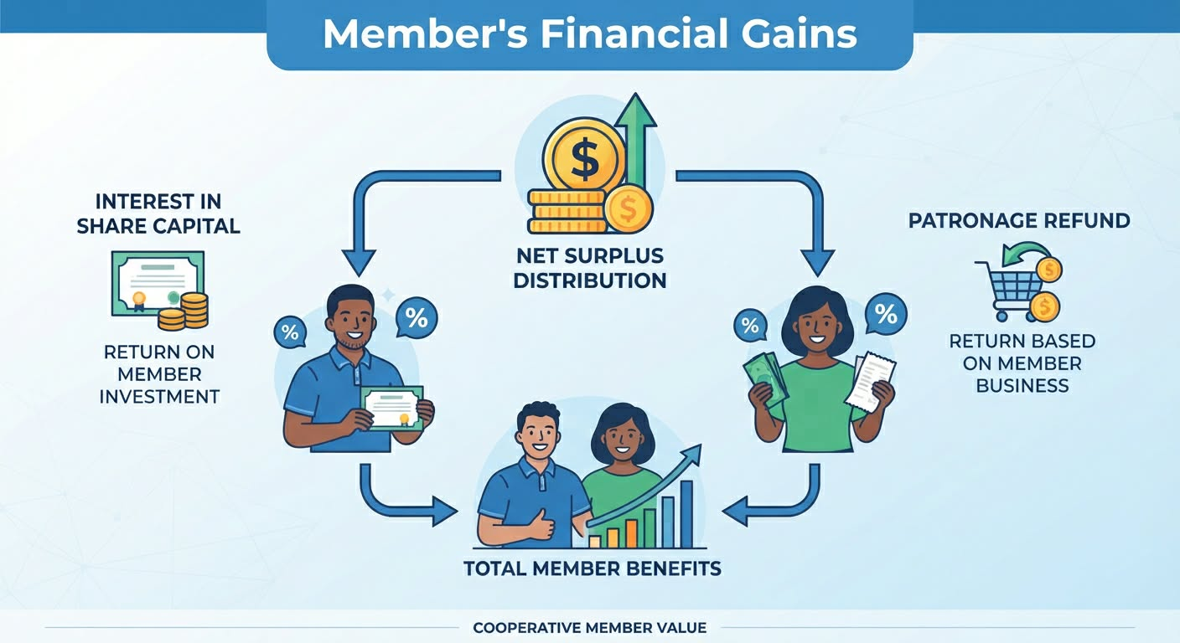

Slide 8


Slide 9


Slide 10


Slide 11
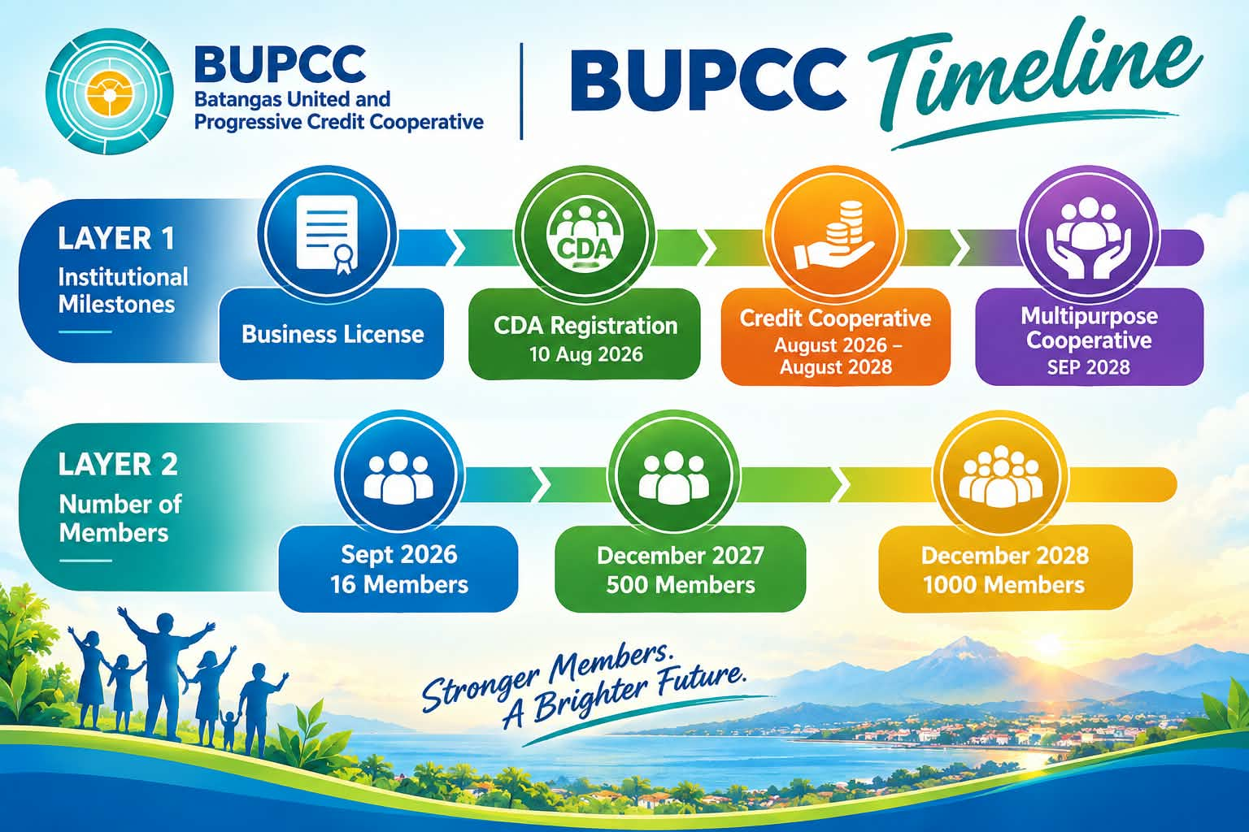
150
300

Slide 12


Slide 13


Slide 14


Slide 15


